Slide 1
Chapter 6 Simulation

Slide 2
Chapter 6 outline
Exploring simulation
Simulating randomness
Creating simulations

Slide 3
Exploring Simulation
Simulation: A simulation is an abstraction of an infinitely complex natural phenomena. It removes details that aren't necessary or are too difficult to simulate. The level of abstraction in a simulation depends on why we're creating it in the first place.

Slide 4
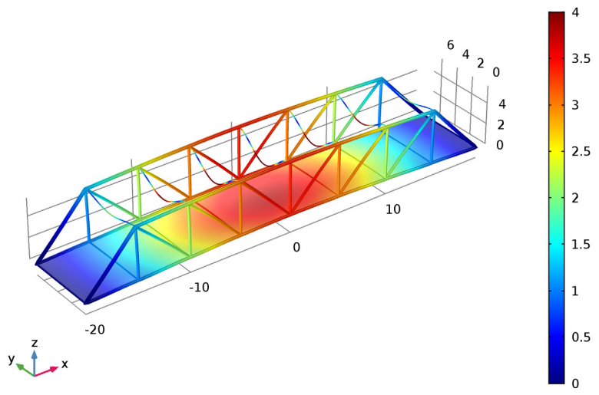
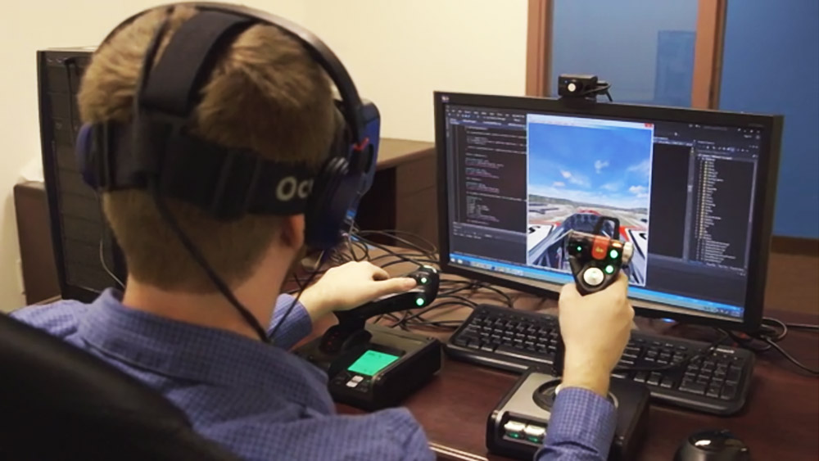
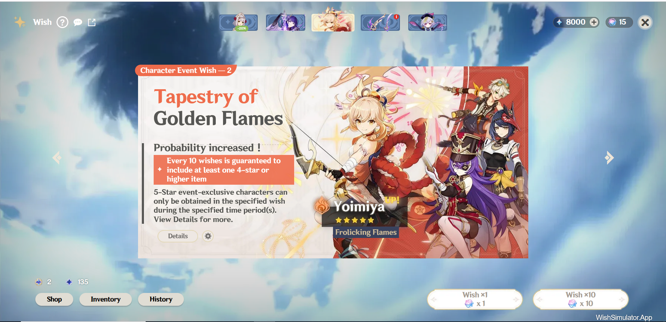
The purpose of simulation
To study systems that are too expensive, too complex to implement in the real-world
Training
Entertainment

Slide 5
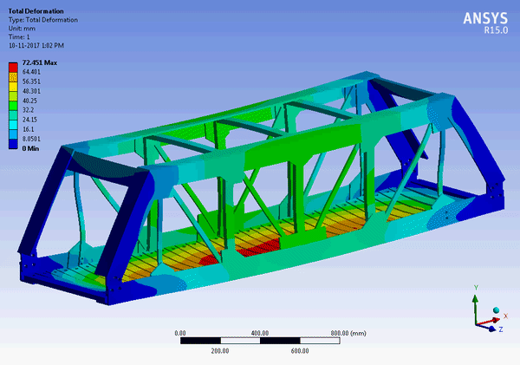
Simulation in Civil Engineering
By subjecting a virtual model of the bridge to simulated loads, engineers can evaluate its response, identify potential weaknesses, and make informed design decisions.

Slide 6
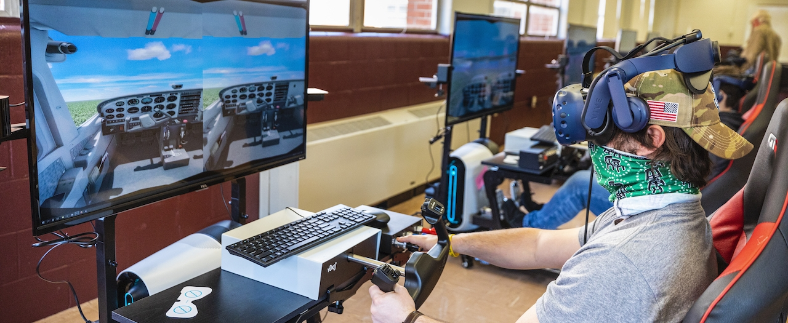
Simulation in Task Training
Flight simulation involves creating virtual models to replicate the experience of flying an aircraft. This simulation aims to provide a realistic and immersive environment for training pilots, testing aircraft systems, and conducting research.

Slide 7
Simulation in Entertainment
Gacha Pull Simulators: These tools allow players to simulate the experience of pulling characters or items without actually spending in-game resources. It's a way for players to see what they might get and experience the excitement without committing to the draw.

Slide 8
Chapter 6 outline
Exploring simulation
Simulating randomness
Creating Simulations

Slide 9
Simulating randomness – Collaborative Coding
I would like to build a game Gacha simulator that has four kind of items {common, rare, epic, legendary}, the drop rates for each type of item should be set to {60%, 30%, 8%, 2%}. I’d like to pull 100 times and see what items I got. How should I implement this program in Python?

